Slide 1


Welcome to our honoured long service colleagues

Slide 2
Thank you for all your hard work, dedication and commitment over the last 20 years to the hospital and Weston Area Health NHS Trust.

Slide 3
Just remember...
when you came to work
on your first day
at Weston
20 years ago...

Slide 4

you went out to watch this at the cinema

Slide 5

...you cried with Tom

Slide 6

...and laughed with Hugh

Slide 7
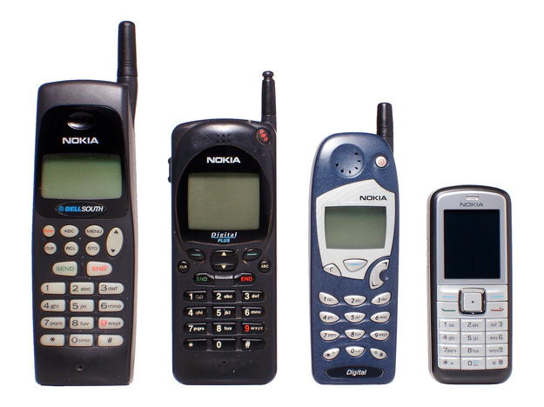
kept in touch with one of these

Slide 8

went on holiday to France on the first time by train

Slide 9
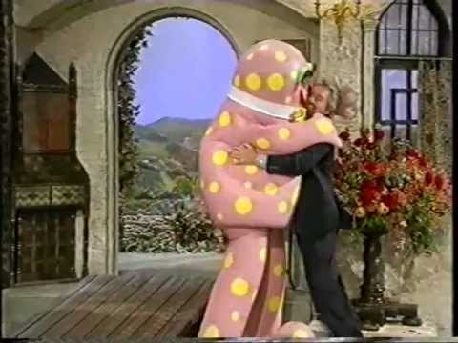
settled down on a Saturday night to watch this

Slide 10
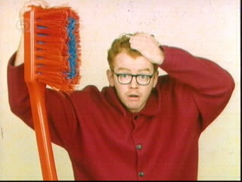
with him...

Slide 11
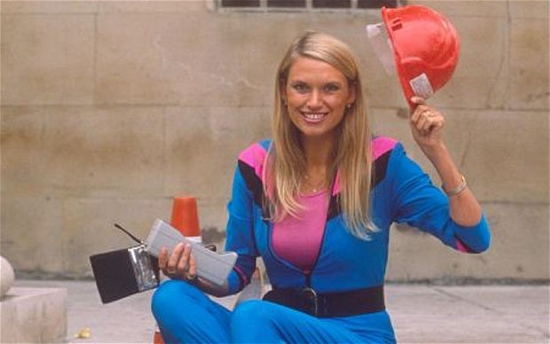
...and her

Slide 12

and this pair were still just pop stars!

Slide 13
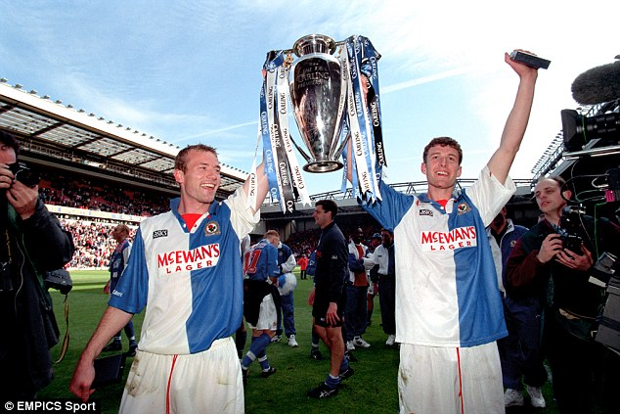
you cheered on these guys..

Slide 14
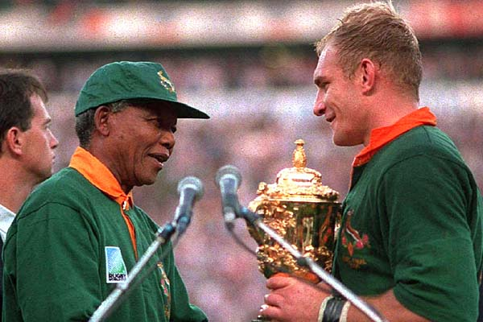
and this game

Slide 15
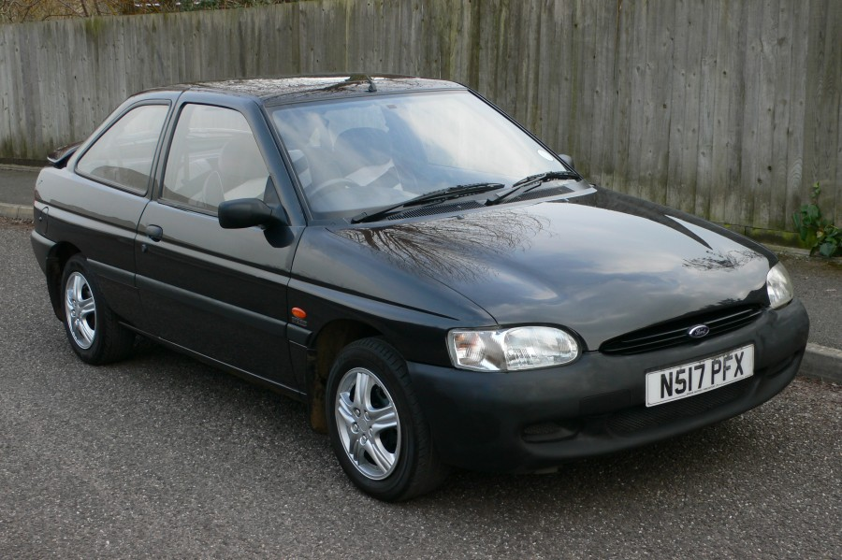
perhaps you drove one of these

Slide 16
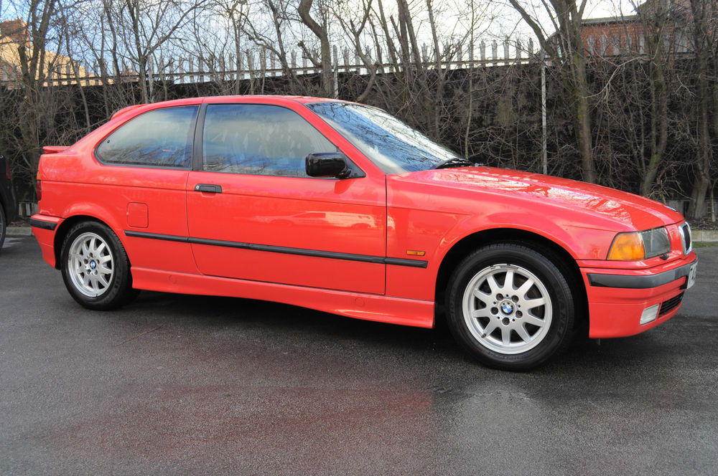
or went on a date in one of these

Slide 17
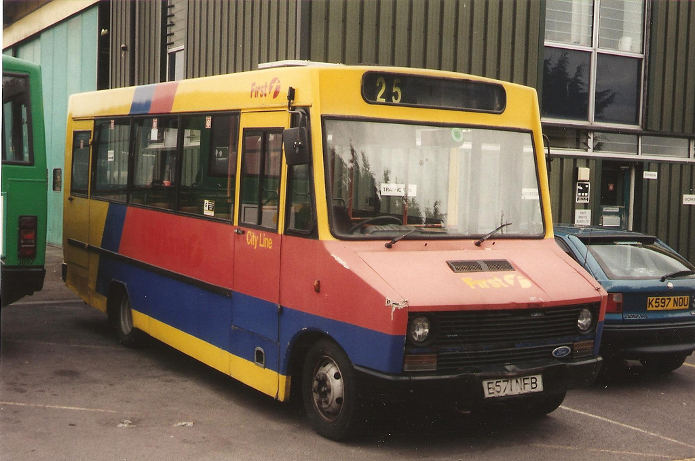
hopped on this

Slide 18
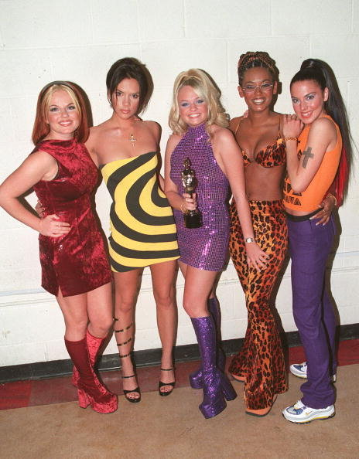
listening to these

Slide 19

on one of these!

Slide 20
but whatever you were doing...

Slide 21
...thank you for doing it with us

Slide 22
congratulations

Slide 23
... here’s to the next twenty years

