Slide 1

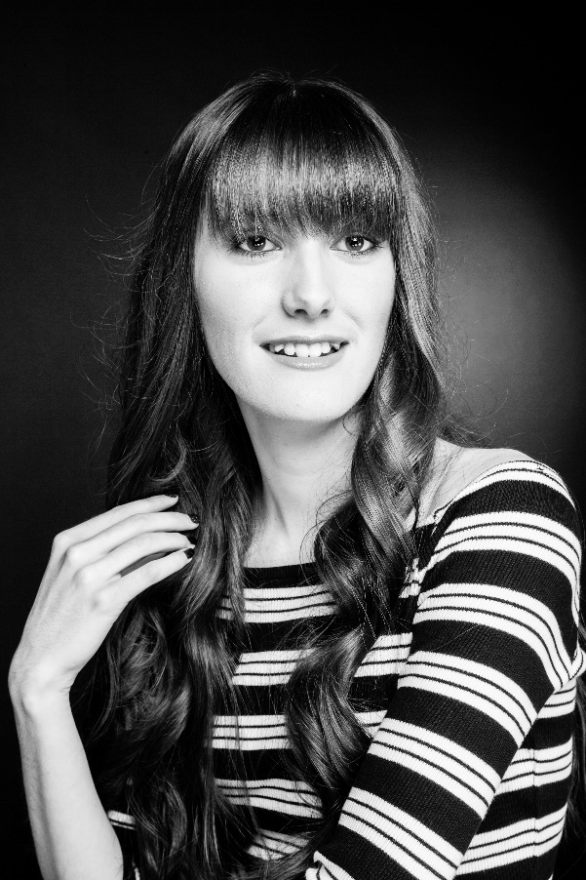
Lauren Smith
Living With Autism
A Different Perspective!
Notes:
It’s a pleasure to be here today to share my personal experience of living with High Functioning Autism. I am 17 and study at Weston Bay, a residential training facility for people with autism. Autism is a condition which affects how I see the world and communicate with others. I find many social situations overwhelming, leading to extreme anxiety.

Slide 2

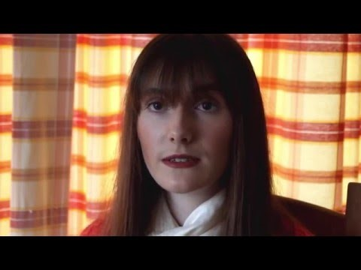
An Insight Into Education
Giving a personal insight into my experiences of school
Offering top tips to other students with Autism
Notes:
At school, I was extremely anxious. The school years were like living hell. I have created a video to provide teachers with an insight into how I felt at school and am hoping that I’ll raise awareness of how students with autism can be supported more appropriately.

Slide 3

Raising Awareness Of Autism
BBC Points West
Danielle Day (Manager of Weston Bay)
Adam Baker (Student at Weston Bay)
Nick Thorne (Student at Weston Bay)
https://www.youtube.com/watch?v=-pgfXIZZtwA&feature=youtu.be
Notes:
As part of my campaign to raise awareness of autism, I was involved in a BBC report on 30th March. Other students, from Weston Bay, were involved. The aim of this report was to promote autism in a positive light and share how Weston Bay can offer support to students.

Slide 4

Meet Me Halfway
Notes:
I have written numerous poems to help express myself. I have created a book that is being passed around today. This extract of one of my poems I’m now going to read, is based on a comment that was made to me by a specialist autism instructor.

Slide 5
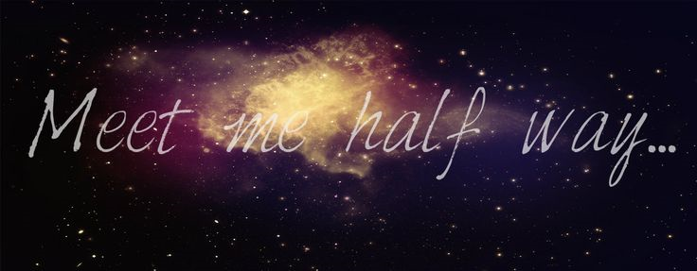
You don’t understand the depths of my emotion,
When you push me into doing things I feel uncomfortable with.
You don’t truly understand the intensity of the anxiety I experience,
So, don’t say that I don’t meet you halfway.
To walk down the street with bustling crowds and flashing lights,
To sit in a class full of commotion and chaos,
To sit in the canteen, desperate for friendship; a sense of belonging,
Causes me immense anxiety and makes me urge to escape.
At college, I have to mask my personality,
Battle my constant fears,
And try to act up to any expectations you set,
And you have the audacity to say I don’t meet you halfway.

Slide 6
I might be lucky – I have all that I need.
But when my anxiety and negative self-talk overflows, I crumble.
Obviously I’m lucky – autism is a gift; a treasure; something to be proud of,
But I struggle immensely with almost everything you take for granted.
My knowledge probably comes across as intimidating,
I’ve researched the condition endlessly.
I’ve devised a set of my own coping mechanisms,
What works for one child with autism, probably won’t work for me – recognising individuality is the key!
The frustrations I experience continually, on a day to day basis, may seem unimportant to you – ridiculous maybe,
You can block out the world whenever you want – I can’t,
I am constantly trapped in a world which seems isolating, confusing and demoralising – I feel deflated.
Yet you feel you can make comments, like ‘you’re not meeting me halfway.’

Slide 7
I’ve said it before and will continue to say it until the message is clear,
Autism is a spectrum condition, but not every person on the spectrum is the same!
The fact is often missed as people with autism share certain traits,
But honestly, we all have different needs and one box doesn’t help us at all – we don’t want to be categorised into what you see as the ‘norm’ or ‘correct way of society.’
I am a person with autism – I am human and I have feelings,
I have a voice and a right to express my own valued opinions,
So, next time you imply you want me to meet you halfway,
Question your knowledge beforehand and consider how making unfair, judgemental, detrimental comments will help me cope.
I will continue to fight for my rights – I’ve fought from the second I was born,
I believe, I should be respected and my differences embraced,
My needs challenged but at my own pace,
My positive contributions and achievements should be acknowledged for one and celebrated for another.

Slide 8

Autism awareness is a highlight for me,
No matter how many books you’ve read, videos you’ve watched or people you’ve spoken to about the subject,
If you haven’t walked my long trudge of a path,
You don’t have the true understanding of the disability.
That’s right – I have a disability,
A hidden disability, where guilt, shame, upset, anger and anxiety threaten to trickle through, when I’m overwhelmed,
My life is a battle – a rollercoaster – a challenge,
So, maybe you should, for once, meet me halfway!

Slide 9


My Rainbow Life
Sharing my perspective of the world through poetry
Raising awareness of the condition
Encouraging understanding of all disabilities
Notes:
I’ve also set up a Facebook page called ‘My Rainbow Life.’ Please have a look if you get a chance.

Slide 10
Promoting Acceptance Of Autism
Autism is a condition that affects the way a person sees the world and interacts with others
Autism is only a part of me; it doesn’t define who I am
Everyone with Autism is different; it’s a spectrum condition
Please Visit Our ‘Light It Up Blue’ Stall
Notes:
Outside, I have a stall based on accepting the condition. Please visit us and enjoy taking blue selfies and eating blue sweets to show you’ve learnt something new about autism.

